Slide 1


PARLIAMENTARY COMMUNICATION SERVICES SUPPORT

Slide 2
BACKGROUND
To support Parliament's strategic plans by increasing the reach, access, and flow of empowering information about Parliament's business, fostering a better-informed citizenry.
Section 59 of the Constitution enjoins Parliament: facilitate public involvement, media access, openness and transparency
1
2

Slide 3
COMMUNICATIONS OBJECTIVES
Improve communication of Parliament's business:
Develop and implement a comprehensive communications strategy to increase public involvement and understanding.
Enhance stakeholder relationships:
Create and execute a stakeholder management plan to strengthen connections with key partners and constituents.
1
2

Slide 4
ORGANIZATIONAL STRUCTURE
Production and Publishing Section:
1. Multimedia Productions Unit
2. Information and Content Development Unit
Media and Stakeholder Relations Section:
1. Media Relations Unit
2. Internal Communications Unit
3. Public Relations Unit

Slide 5
MESSENGERS
Speaker of the National Assembly
Chairperson of the NCOP
Deputy Speaker and Chairperson
House Chairperson
Chairpersons of Committees
Secretary to Parliament
Parliament Spokesperson

Slide 6
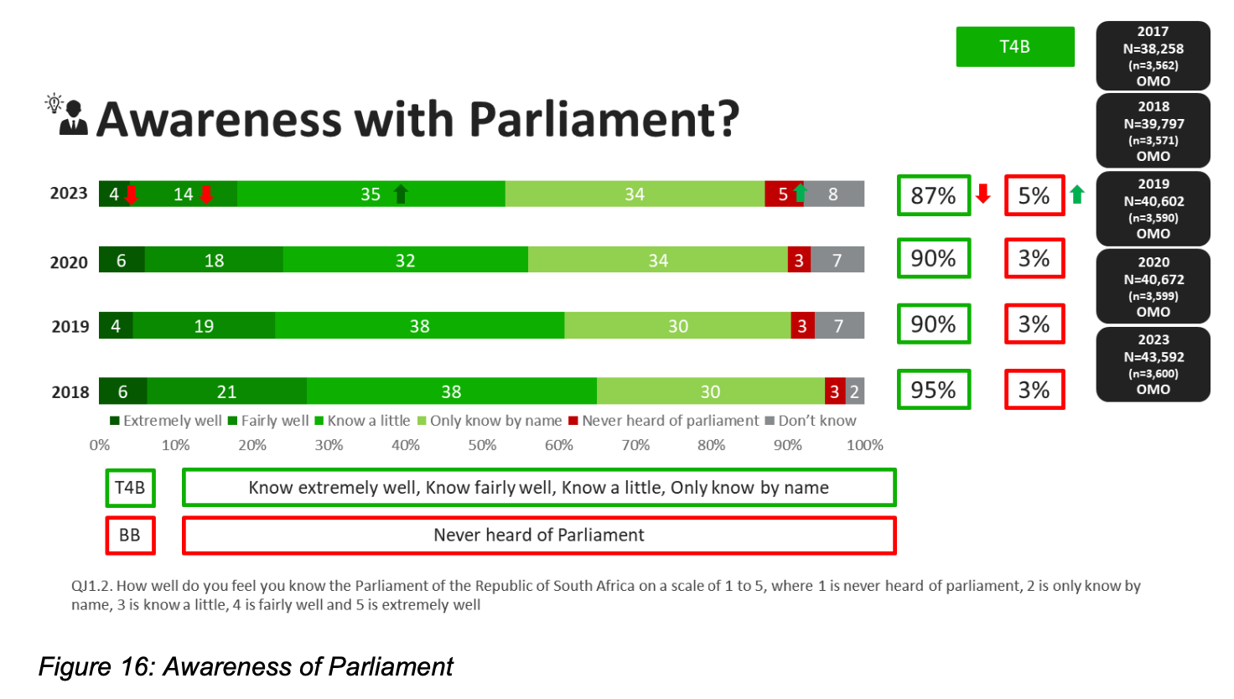
KEY COMMUNICATIONS STATS

Slide 7
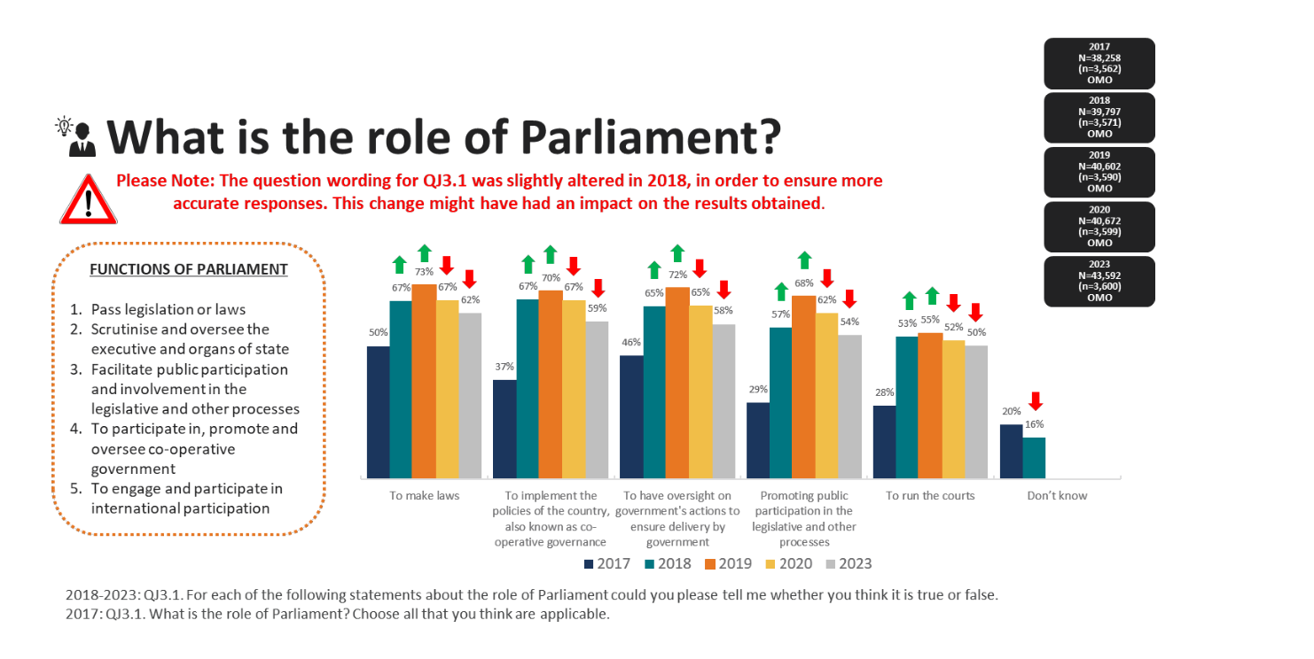
KEY COMMUNICATIONS STATS

Slide 8
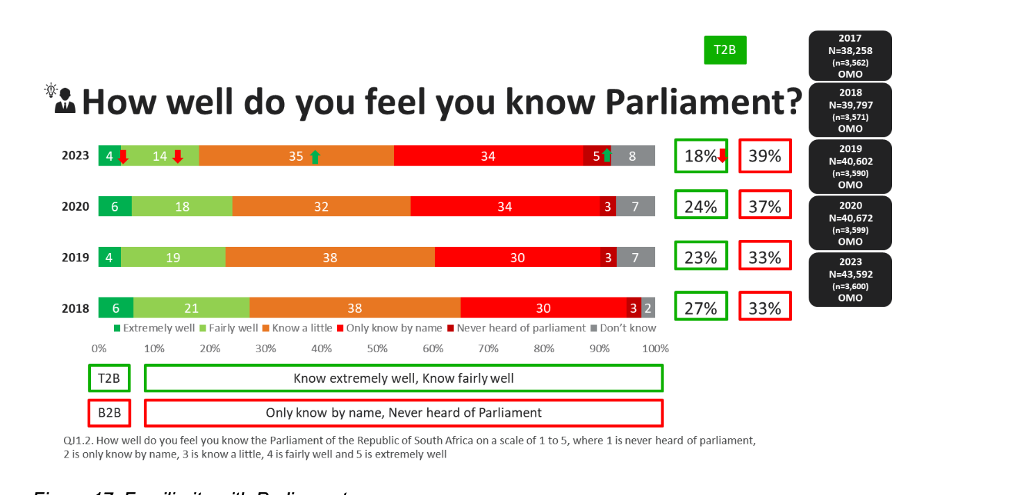
KEY COMMUNICATIONS STATS

Slide 9
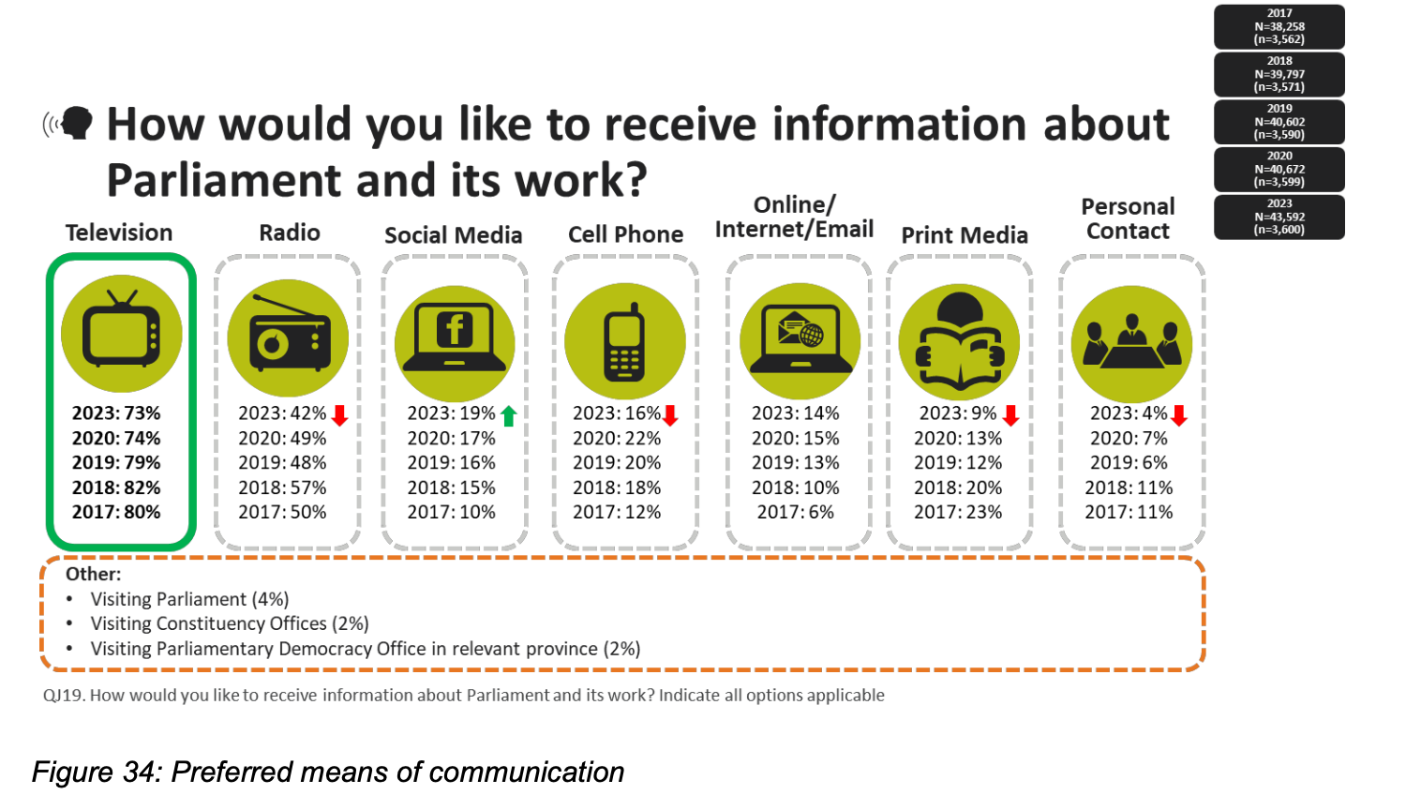
KEY COMMUNICATIONS STATS

Slide 10
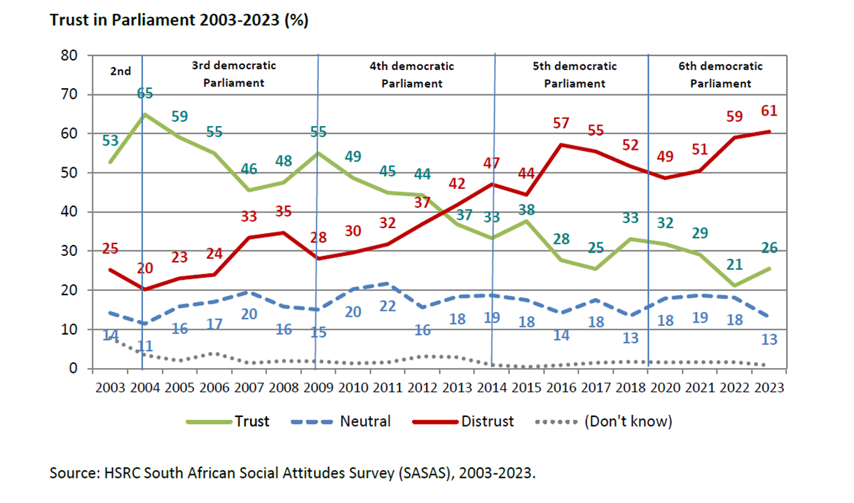
KEY COMMUNICATIONS STATS

Slide 11
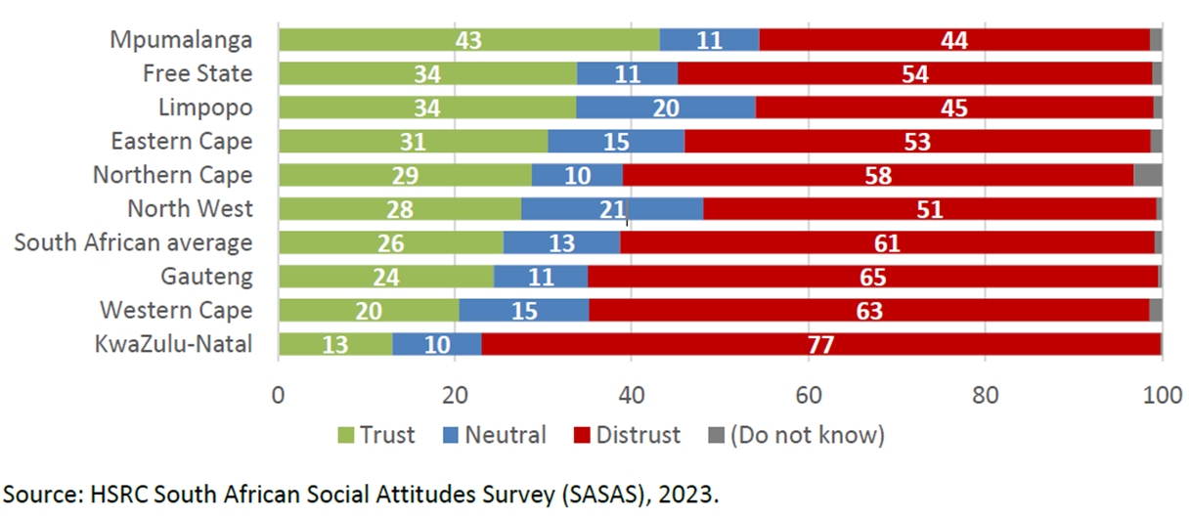
KEY COMMUNICATIONS STATS
Trust in Parliament is lowest in Gauteng, Western Cape and KwaZulu-Natal, and when respondents’ replies are segmented youth emerges with the highest mistrust levels. These records will inform the intervention strategies.

Slide 12
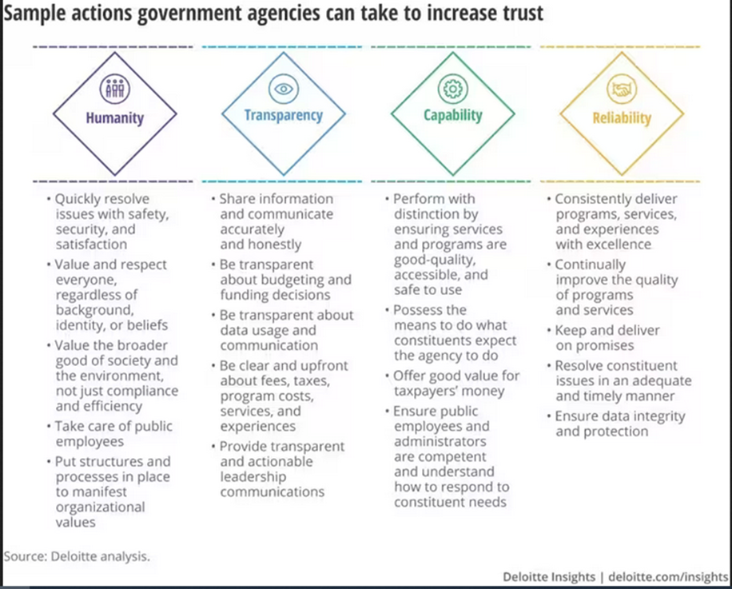
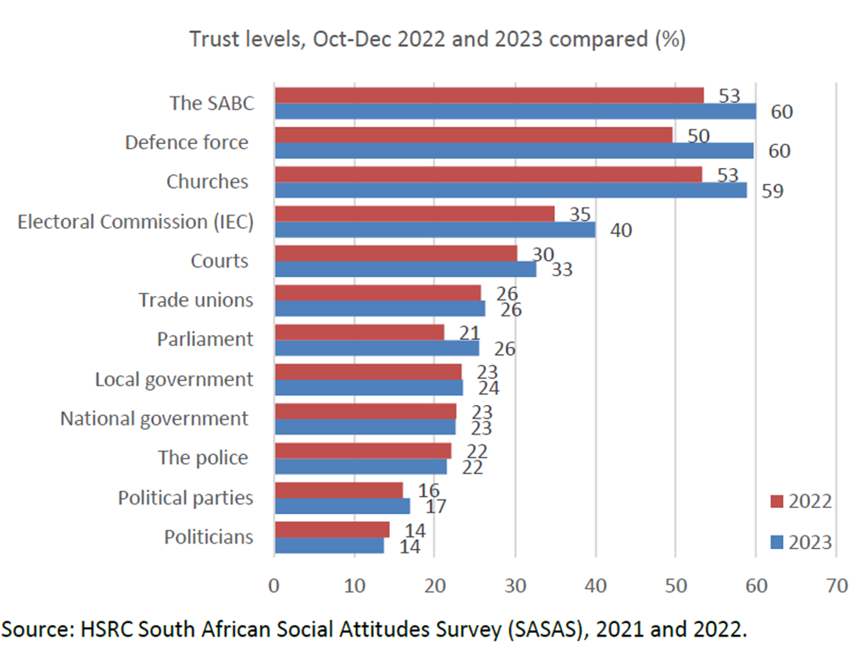
This broader outlook shows potential strategic partners (SABC, Churches, etc.) as well as approaches to Trust-Turn Around Strategies

Slide 13







CORE SUPPORT SERVICES
Staffing Ratio and Coverage
Committee Publicity
Media Coordination
Content Development
Media Monitoring and Analysis
Public Involvement and Participation
Website Management and User Experience

Slide 14
CORE SUPPORT SERVICES
Committee Chairs generated 113 media mentions and an AVE of R5,666,397. The overall PropAVE percentage is 75%. Violet Siwela led coverage with 22 mentions and a PropAVE percentage of 100%. Coverage overall for Chairs was led by online media at (35%) followed by print media at (34%) and then broadcast media at (31%).

Slide 15
DIGITAL STRATEGY AND SOCIAL MEDIA MANAGEMENT
Develop and implement robust digital strategies
Manage official social media accounts
Create engaging social media content
Monitor and respond to public engagement online

Slide 16
COOPERATION REQUIREMENTS
Accessibility needs for media and public engagement
Swift approval processes for communications
Active participation in multimedia activities
Accessibility and Availability
Open Communication with PCS Team
Collaborative Content Development
Social Media communications

Slide 17
ETHICAL CODE OF CONDUCT FOR SOCIAL MEDIA
Bringing Parliament into disrepute
Use derogatory, racists, sexist language or content
Incite violence or promote hate speech
Like, share or comment on content that is derogatory,
Racist, sexists or promotes hate speech in order to promote such content

Slide 18
FUTURE PLANS AND STRATEGIC DEVELOPMENT
Media training for Chairpersons
Weekly clusters media engagement
Parliamentary TV channel enhancements
Expanded broadcast capabilities
Thought leadership programs
Committee-specific social media accounts

Slide 19
END

