Slide 1
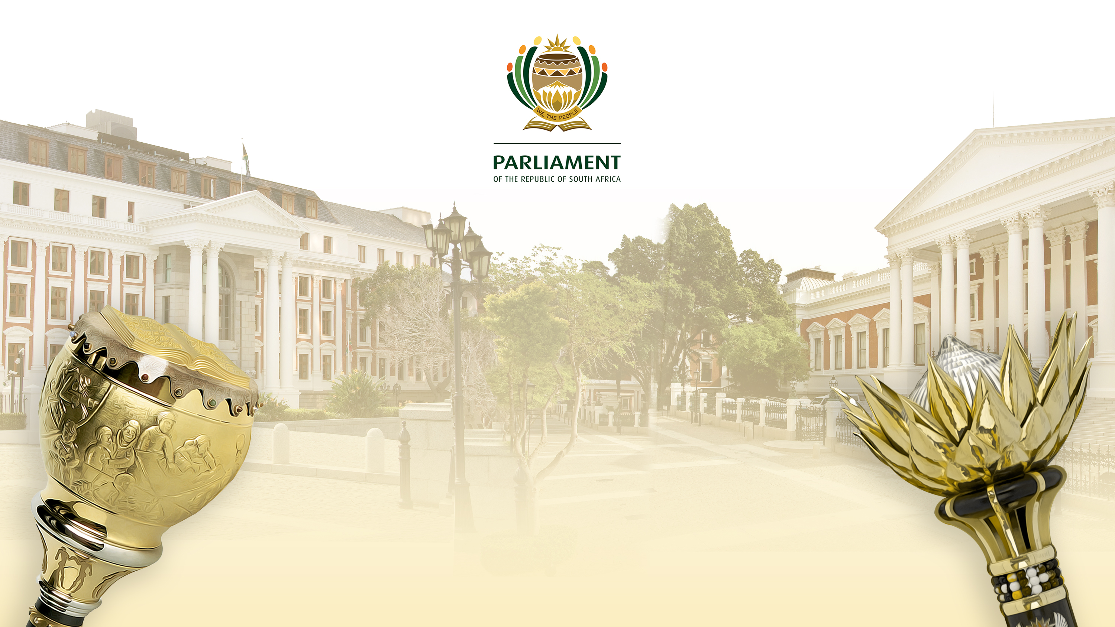
PARLIAMENTARY DIPLOMACY AND PROTOCOL
NA Chairpersons Induction, Sandton
7 – 8 August 2024

Slide 2
CONTENTS
Contextual background on the role of parliaments in international relations
South Africa’s Parliamentary Diplomacy: Policy framework and Scope
Protocol and Ceremonial Services
Support to Members of Parliament (MPs)

Slide 3
Contextual Background: The role of parliaments in international relations
The role of parliaments in international relations is multifaceted and essential for representing the country’s interests, contributing to global governance, and fostering international cooperation and peace. Key aspects of this role include:

Slide 4
Cont. Background (continued)

Slide 5
South African Parliamentary Diplomacy: Policy Framework and Scope
Since 1994, the South African Parliament has actively participated in bilateral and multilateral international engagements, increasingly being understood as parliamentary diplomacy.
Parliamentary diplomacy involves collaborative interactions with parliamentary and relevant non-parliamentary actors at the international level. It aims to strengthen domestic constitutional mandates while complementing the executive branch’s efforts in promoting foreign policy objectives, constitutional values, and national interests.
Parliamentary Diplomacy: Presents significant opportunities to:
Exchange knowledge and experiences with parliamentarians from other countries.
Promote a peaceful and interconnected world.

Slide 6
South Africa’s Parliamentary Diplomacy (Continued)
Advocate South Africa’s constitutional values among parliaments from other countries.
Complement the efforts of the executive in pursuing South Africa’s interests and foreign policy objectives.
Strengthen South-South and South-North cooperation for mutual benefit and shared prosperity.
In conclusion, parliamentary diplomacy presents opportunities for meaning meaningful engagement with international partners while promoting fundamental values and advocating for key national priorities on the global stage.

Slide 7
Parliamentary Group on International Relations (PGIR)
The PGIR is a strategic body that was established in 2009 by the Joint Rules Committee (Joint Rule 76 to 79). Its mandate is to manage, coordinate and provide strategic direction on Parliament’s international engagements, including its relations with other Parliaments and international parliamentary organisations. It is also mandated to receive and approve reports from parliamentary delegations as well as submitting these for publication in Parliament’s Announcements, Tabling and Committee Reports (ATC) publication. Its co-chairpersons are as follows:
The House Chairperson on International Relations in the National Assembly (NA), designated by the Speaker of the NA.
The House Chairperson on International Relations and Member’s Support in the National Council of Provinces (NCOP), designated by the Chairperson of the NCOP.

Slide 8
Key role players
At the political level:
The Parliamentary Group on International Relations (PGIR)
The Joint Rules Committee.
Presiding Officers.
The House Chairpersons of International Relations in both Houses of Parliament.
MPs.
At the administrative level: Support is provided by the Secretary to Parliament, primarily through the International Relations and Protocol Division.

Slide 9
Legislative and Policy Framework
The Constitution of the Republic of South Africa (1996)
White Paper on South Africa's Foreign Policy (2011)
National Development Plan 2030
Southern African Development Community Revised Regional Indicative Strategic Plan
African Union Agenda 2063 and its project African Continental Free Trade
The Framework Document on South Africa’s National Interests 2022
Reviewed Policy Perspective & Operational Guidelines for Parliament (2024) and 7th Parliament's Strategic Plan

Slide 10


Bilateral vs Multilateral Parliamentary Diplomacy
Bilateral
Multilateral
Involves interactions between two countries’ legislatures, or specific chambers
Some formal/informal, some ad hoc interactions
To share information on their governments’ (executive) relations
Often to learn from each other (how they function)
Staff exchanges
Vote together at multilateral conferences
The mechanisms used to formalise bilateral relations are Memoranda of Understanding (MoU).
Involves interactions among multiple parliaments through affiliation to IPIs, conferences, etc,.
Non-binding powers → resolutions & motions
Share knowledge and experiences through motions, debates, speeches etc.
Debate motions and agree to resolutions to share with executive + implement in national parliament (soft power influence)
Participation in election observation missions

Slide 11
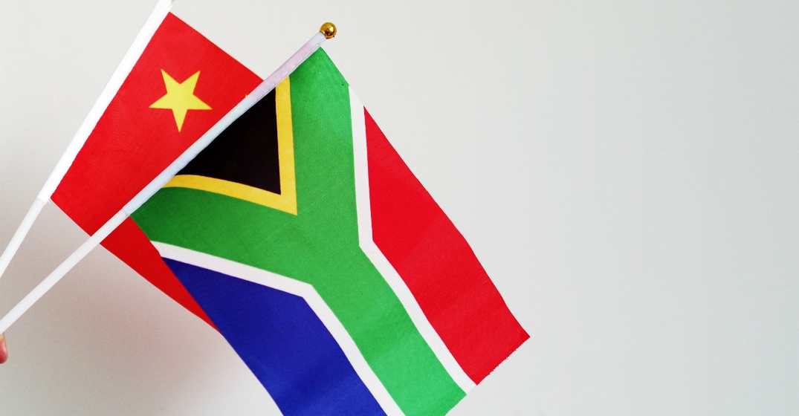
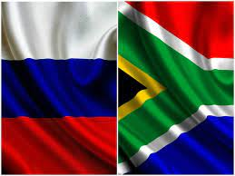

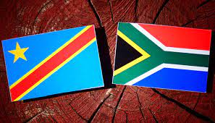
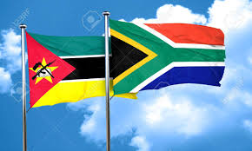
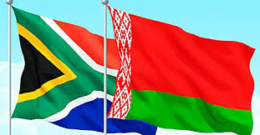
Bilateral level
Over the years, the South African Parliament concluded the following MOUs:
SA-EU
SA-PRC
RUSSIA
DRC
MOZAMBIQUE
BELARUS

Slide 12
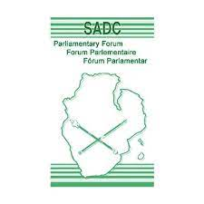




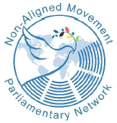
Multilateral Level
The South African Parliament’s multilateral activities:

Slide 13
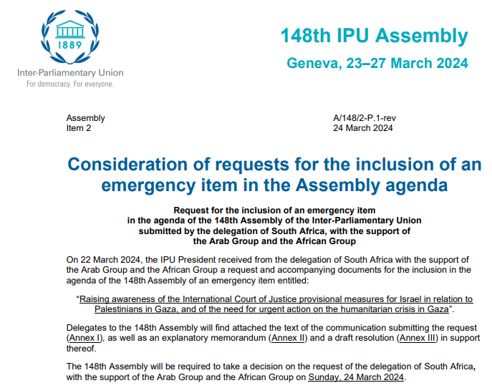
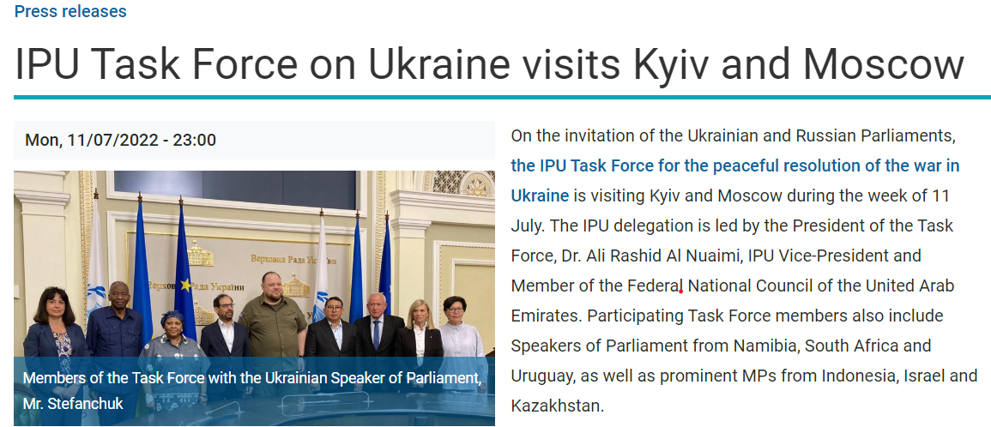
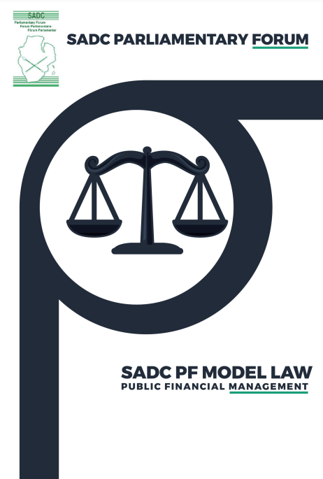
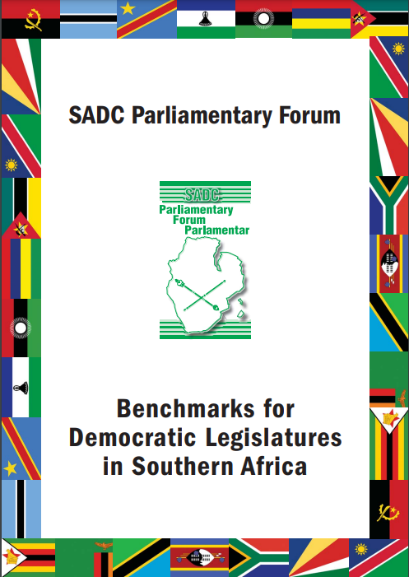
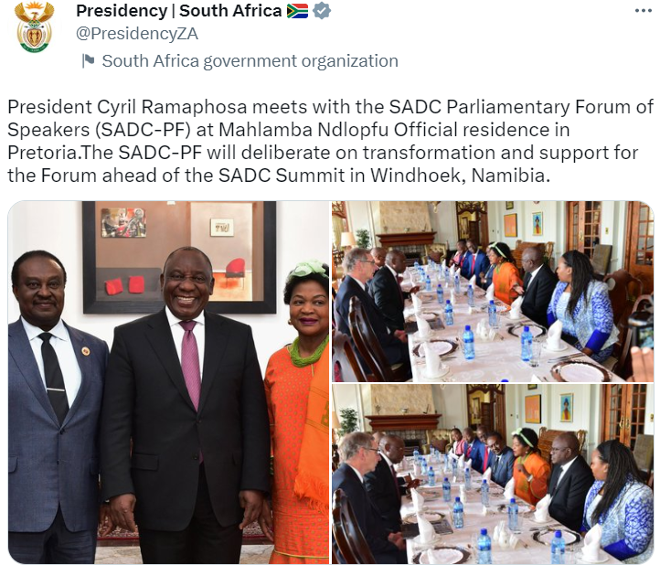
SUCCESSES
Leadership positions → Promote SA values and interests through control over agenda
Successfully moving motions, which become IPI resolutions
Initiating emergency items for debate at international level
Contributing to resolutions and model laws → impacting docs to UN and other executive bodies → can affect other countries’ national laws on subject
Lobbying heads of state
Facilitating conflict resolution
Capacitating IPIs through staff secondments → promoting SA values

Slide 14
Protocol and Ceremonial Services
Protocol and ceremonial services encompass a set of formalities and procedures designed to ensure proper etiquette, decorum, and adherence to established norms during diplomatic engagements and official events. These services are crucial for maintaining the dignity and respect associated with international relations and ceremonial occasions.
The International Relations and Protocol Division (IRPD) renders protocol and ceremonial support to Parliament, particularly the Presiding Officers, in the execution of their ceremonial and diplomatic duties. The services include:

Slide 15
Protocol and Ceremonial Services (continued)
Rendering of Protocol and Ceremonial services and support to Presiding Officers on official engagements (local and abroad) and visiting dignitaries hosted on official occasions.
Coordination and facilitation of Parliament’s protocol related to official diplomatic correspondence, e.g. with the Presidency and the Department of International Relations and Cooperation (DIRCO), correspondence with multilateral organisations, and communication with members of the diplomatic corps.
Providing general advice as needed on protocol operations, in accordance with national and international protocol practices.
Condolence book preparation.
Official gifts procurement and management.
Initiating a protocol training programme for Parliament

Slide 16

Support to Members of Parliament (MPs)
The International Relations and Division provides the following support to Members participating in parliamentary diplomacy:
Organising briefing meetings in preparation for engagements.
Providing the necessary content or briefing documents, in line with the agenda or thematic area of each activity (meetings, seminars, plenaries, conferences, etc).
Protocol and ceremonial arrangements and guidance.
Administrative and logistical arrangements and support.
On-site support by accompanying Members during an activity.
Drafting of delegation reports and capturing of key resolutions and issues.

Slide 17

KEY TAKE- AWAYS
Parliament's involvement in bilateral and multilateral parliamentary diplomacy serves several key purposes:
Learning and Improvement: MPs can use these engagements to learn from their international counterparts, exchanging best practices to enhance their legislative and oversight work back home.
Promotion of South Africa and Africa's Interests: Through diplomatic engagements, MPs can actively advocate for the interests and priorities of Africa, contributing to regional integration and addressing common challenges faced by African nations.
In summary, parliamentary diplomacy allows South African MPs and committees to enhance their legislative abilities, advocate for national interests, and promote the welfare of the African continent on the global stage through constructive international engagement.

