Slide 1


CONSTITUTIONAL AND
LEGAL SERVICES OFFICE
7th Parliament
Induction of Chairpersons

Slide 2
KEY SERVICES
(OVERVIEW)

Slide 3
PROVIDE LEGAL ADVICE (Oral and Written)
Classifying Bills
Contracts Vetting
Petitions
Rules and Amendments
Legal Compliance and Constitutionality
Draft Policies (including advising on existing policies)
International Agreements
Bills and Amendments

Slide 4
LEGAL DRAFTING
Legislation initiated by Parliament:
Private Members / Committee Bills
Amendments to, or redrafting of, Executive Bills
Contracts/Policies and proposed changes
Review of Statutes

Slide 5
PROCESSING OF BILLS AND ACTS
Monitoring compliance with rules
Edit and introduce official text bills
Edit and publish 2nd language bills
Track official passage of bills
Report to programming committee on status of bills
Processing Act forms for assent and safekeeping

Slide 6
LITIGATION MANAGEMENT
Study papers served
Provide strategic guidance in the management of matters
Liaise with necessary role players (including the Spokesperson and relevant Committees as required)
Judgment Analyses
Impact Assessment for future legislative processes

Slide 7
OPERATING PROCEDURES
(Overview)

Slide 8
PROVIDE LEGAL ADVICE
STANDARD SEVEN WORKING DAYS TURN AROUND TIME:
Request for advice received by CLA
Request allocated to a Legal Adviser
Engagements with clients to gain clarity
Collection and collation of documents to complete the brief
Record due date according to the agreed timeframes
Conduct analysis of request

Slide 9
PROVIDE LEGAL ADVICE (cont.)
Conduct Research
Draft Legal Advice
Submit to the Senior Legal Adviser for quality check
Submit to Chief Legal Adviser for approval and signature
Submit Legal Advice to the Client

Slide 10
LEGISLATIVE DRAFTING
STANDARD AT LEAST THREE MONTHS TO DEVELOP FIRST DRAFT:
Exact time it may take to develop legislation depends on complexity of subject matter
Allocation of request received
Evaluating the request to establish the policy: What is the mischief/purposes/intended impact?
Further engagement with client (if required) to clarify brief
Commence drafting of Bill, in consultation with client (multiple drafts may be required).
Finalisation of draft bill, subject to peer review and quality control
Issue a certificate of rules and constitutional compliance

Slide 11
LEGISLATIVE DRAFTING (cont.)
Related Support:
  Assist Members to publish and introduce Private Members’ Bills
  Advise on the proposed classification of Private Members’ Bills and Committee Bills
  Consider gaps in the statute book, with due regard to Constitutional Court judgments

Slide 12
BILLS AND ACTS PROCESSING (Bills Office)
Assistance with editing, publishing and tracking of Bills:
Editing, publication and introduction of Bills (official text in English)
Editing and publication of Bills (2nd language translations)
Publishing of Announcements, Tablings and Committee Reports (ATCs)
Tracking of Bills and updating of related indexes
Status reports on tracking of Bills to Programming Committees
Processing, editing and finalising of Act forms
Submission to the President for assent
Submission of final copy of assented act to Constitutional Court

Slide 13
BILLS AND ACTS PROCESSING (cont.)
Responsibilities re Parliamentary Papers:
Create ATC content:
  Communicate with contributors
  Ensure procedural correctness of legislation progress captured
Quality control, review and approve the draft ATC
Send to external printers
Circulate settled copy / publish on website

Slide 14
LITIGATION MANAGEMENT
Process Service (as per Court Rules and legislative requirements)
Advise Principals on recommended position
Proceed to abide/oppose/settle as authorised
Instruct Attorney and Brief Counsel
Preparation of papers as required by litigation strategy and court directions
Provide progress updates as per the needs of the case
Advise on how orders are to be implemented

Slide 15
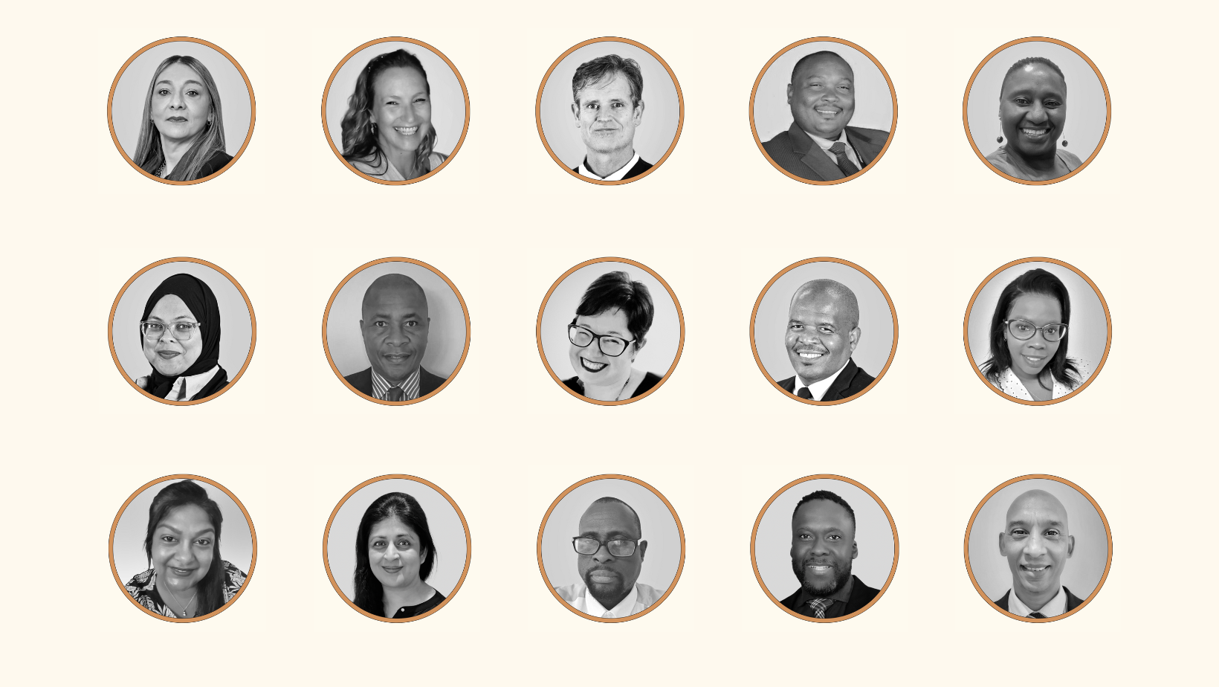
OUR TEAM
Adv Zuraya Adihkarie
Chief Legal Adviser
Adv Charmaine vd Merwe
Senior Legal Adviser
(Drafting)
Adv Frankie Jenkins
Senior Legal Adviser
(Advisory)
Mr Siviwe Njikela
Senior Legal Adviser
(Litigation)
Dr Thobile Mbatha
Chief Bills Editor
Ms Aadielah Arnold
Legal Adviser
Mr Andile Tetyana
Legal Adviser
Dr Barbara Loots
Legal Adviser
Mr Bulelani Simani
Legal Adviser
Ms Buyiseka Mtati
Legal Adviser
Ms Daksha Kassan
Legal Adviser
Ms Fatima Ebrahim
Legal Adviser
Mr Lehotlo Moshokoa
Legal Adviser
Mr Lonwabo Sopela
Legal Adviser
Mr Michael Prince
Legal Adviser

Slide 16

OUR TEAM
Ms Phumelele Ngema
Legal Adviser
Ms Sueanne Isaac
Legal Adviser
Ms Telana Halley-Starkey
Legal Adviser
Ms Thiloshini Gangen
Legal Adviser
Ms Zingisa Zenani
Legal Adviser
Adv Makgothu Motasi
Assistant Bills Editor
Dr Ziningi Cele
Control Editor
Mr Adriaan Cupido
Editor
Ms Lungile Mbhele
Editor
Mr Njabulo Ngwenya
Legal Intern
Ms Lynette Adams
Executive Secretary
Adv Shamiela Peer
Legal Assistant
Mr Clifford Cuba
Administrative Officer
Ms Unathi Mdaka
Secretary

Slide 17
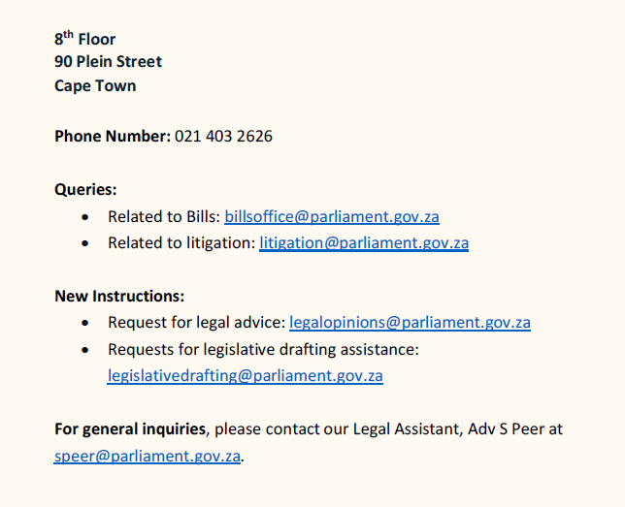
CONTACT DETAILS:

Slide 18

CLSO BROCHURE:

