Slide 1

South African Legislative Sector - A Collaboration of Parliament and Provincial Legislatures -
Role and support provided by Legislative Sector Support (LSS)
7-8 August 2024

Slide 2
SALS Legal Basis & Commitment to Collaborate
Section 40 of the Constitution - legislative bodies are independent, but interrelated & interdependent (regulated by MoUs, SALS Constitution, Sector Bill in process)
Adhere to & advance the principles of co-operative government (not encroach geographical, functional or institutional integrity)
Legislatures must co-operate with each other in mutual trust & good faith
Overall aim is to strengthen the Legislative arm of government through Cooperative Governance
Develop all legislatures continually to serve and enhance democracy
Recognition of the need to collaborate on matters of common interest
Develop common norms and standards based on similar mandates – resulting in similar or aligned programme implementation by legislatures
Facilitate greater cooperation and cohesion among institutions
Learning organisations, share and exchange knowledge

Slide 3

The SA Legislative Sector
Collaboration & cooperation of Parliament and Provincial Legislatures - coordinated through various joint sector structures established.
Speakers’ Forum SA, Reference Groups (Sub-committees)
Forum of Secretaries, SALS Clusters & Professional Forums
Other sector structures – Chair of Chairs Forum, SA Parliamentary Institute (SAPI), APAC, SALSEO, SALS
Bargaining Forum
Coordination, management, technical & secretariat support is provided by the Legislative Sector Support mechanism placed in Parliament
Local Government relations – SALGA President to SF, Secretaries’ level engagement – towards potential integration to sector joint structures

Slide 4

South African Parliamentary Institute (SAPI)
The South African Parliamentary Institute was established in Dec 2021, as one of strategic interventions of the Legislative Sector.
To contribute to Sector efforts of building an arm of state that is responsive and positively contributes to the transformational agenda of the country.
Four pillars – Capacity Building; Research & Knowledge Management; Technical & Advisory Services & Alumni Association & Partnerships.
6th Term – establishment & institutionalization phase, amidst Covid-19 restrictions and the fire that gutted Parliament.
Instrumental in delivering capacity building programmes in the 6th Term, key focus for 7th Term is to ensure all pillars of the institute are functional.
SAPI is governed by a board (11 members) appointed by & reporting to the Speakers’ Forum
Legislative Sector Support provides management, administration & secretariat support

Slide 5
Committee Specific Matters
Chair of Chairs Forum activation (House Chairs NA, NCOP & Chair of Chairs: Provincial Legislatures)
Envisaged – Stronger Collaboration of Committees (& Chairs) across Sector
Professionalisation of Sector – SA Parliamentary Institute
Capacity Development – Orientation & Induction of Members & Committees, long-term & short learning programmes & committee specific skills training, other relevant training – e.g. media handling training
Core Business related work – Sector Programmes & Projects on Oversight, PP, Lawmaking & Procedural (Champion sector work in Legislatures)
International Relations work – Coordination of SA Delegation to CPA (CWP, SoCATT), SALS-EU relations

Slide 6
Sector Core Business matters
Local Government Role – support to Local Gov, oversight enhancement at Local Gov, SALS-Local Gov relations
Oversight Enhancement – SOM assessment & review, Oversight Coordination (3 spheres), Oversight Tools (Oversight Index)
Public Participation Enhancement – PP Survey, Involvement of Vulnerable groups, PP Tools (PP Index)
Other Sector Interventions – Gender Sensitive budgets – Gender Responsive Budgeting Framework for Sector, Use of Oversight Info from Relevant Bodies, BIMS Knowledge Management System
Lawmaking – SALS Bill, FMPPLA amendment & regulations, SALS Integrity Legislative Framework

Slide 7
Academic & Short Learning Programmes
UNIVERSITY OF WITWATERSRAND
Graduate Certificate in Governance
and Leadership
Postgraduate Diploma in in
Governance & Leadership
Masters of Management - Governance
and Leadership
UNIVERSITY OF JOHANNESBURG
Certificate in Public Policy
Postgraduate Diploma in Public Policy
and African Studies
Free online learning available for
Commonwealth Parliamentary
Association branches.
Short Learning Programmes
Course in Parliamentary Decorum
Programme in Legislative Process
Programme in Public Participation
Course in Legislative Drafting
Evidence based policy making course
ICT Programmes (offered in Legislatures)
Further programmes will be added in
2025 include but not limited to:
Speed reading
Media handling
Social media training
Public speaking

Slide 8
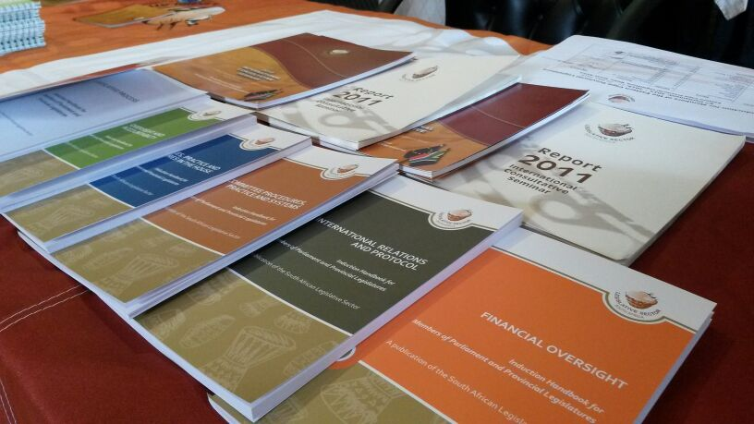
Comprehensive Induction Programme for Members
Induction handbooks
Module 1: Rules, Practice and Procedure in the House
Module 2: The Legislative Process
Module 3: Committee Procedures, Practice and Systems
Module 4: Oversight & Accountability
Module 5: Public Participation
Module 6: International Relations & Protocol
Additional learning materials:
Practical guide 1:
Members and law-making
Practical guide 2:
Members and oversight
Practical guide 3:
Members and dIplomacy & protocol

