Slide 1

CORE BUSINESS SUPPORT DIVISION SUPPORT SERVICE TO COMMITTEES
NATIONAL ASSEMBLY ELECTED COMMITTEE CHAIRPERSONS’ INDUCTION
7-8 AUGUST 2024, SANDTON

Slide 2
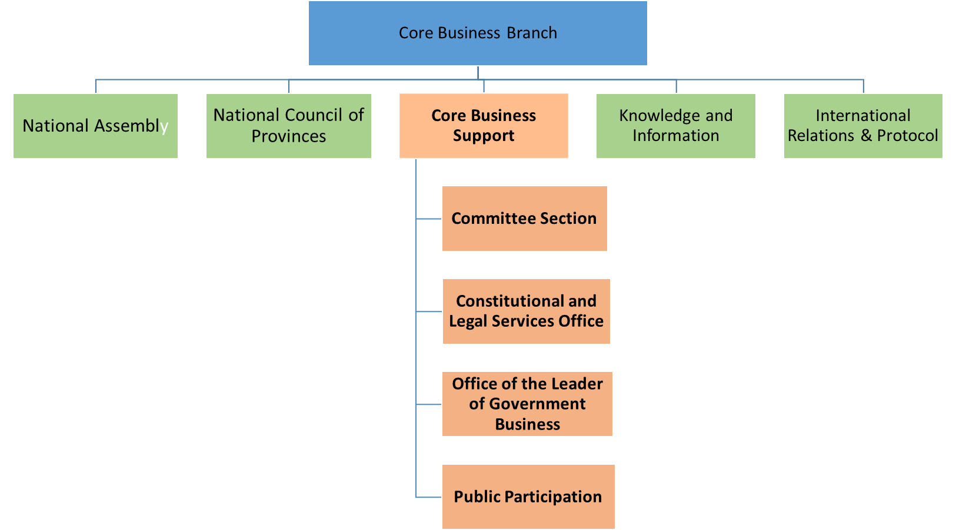
CORE BUSINESS BRANCH
OISD

Slide 3
Purpose
Core Business Support Division (CBS) supports the core mandates of Parliament namely law-making, oversight, public participation, cooperative government and international engagement.
The Division provides:
Procedural advice,
Content support,
Secretarial support
Logistical support; and
Conduit to Leader of Government Business
to committees of National Assembly and National Council of Provinces.
CBS provides public education programmes, information and access to support public participation activities of the Houses and committees.

Slide 4

Committee Section
Provides the following support:
Procedural advice
Secretariat support
Content support
Logistical support

Slide 5
Committee Section
Content Advisor: responsible for provision of content advisory services as they relate to portfolio matters before the committee
Committee Secretary: mainly responsible for secretariat support and providing procedural advice to the committee
Committee Assistant: responsible for logistical support to select committee
Executive Secretary: manages the office of the committee Chairperson
All the Committee support staff report to a Unit Manager responsible for a cluster of Select and Portfolio Committees
Unit Managers report to the Section Manager: Committee Support

Slide 6

Public Participation
Public Participation Section comprises : Public Education Office and Parliamentary Democracy Offices (PDO)
Key focus is to educate the public on how to get involved in parliamentary processes
E.g. Law-making and oversight processes, mechanisms to participate such as petitions, representations and how to make a submission on a bill before a committee to prepare participants for a public hearing on the bill.
Parliamentary Democracy Offices (PDOs) in 3 provinces Northern Cape (Kakamas), Limpopo (Ga-Matlala Thaba) and North-West (Ganyesa) provinces
PDO’s allow for coordinated public participation and involvement in legislative processes and other processes of Parliament
They also enable Parliament to reach citizens in the rest of South Africa who are not able to attend parliamentary proceedings in Cape Town.

Slide 7




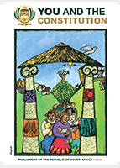






Products and Services
To fulfil these objectives, PEO and PDO render a package of integrated services
Content Development for Different Parliamentary Platforms
Virtual & Physical
Workshops
Bite-Size Messages
Edit Text
Edit Text
Interactive learning tools
Electronic & Courier Distribution of Learning Materials
Edit Text
Edit Text
Community Radio Programmes
Parliamentary
Corners
Edit Text
Edit Text
Virtual Tours of Parliament
Stakeholder Engagements
Notes:
Public participation is one of the hallmarks of a democratic government
South is in a unique position in that public participation is constitutionally entrenched in the country and there are mechanisms to ensure that the public is included in all processes of law making
South African Parliament has sought to increase access and improve the quality of participation through various programmes such as public hearings, petitions, lobbying, submissions, “Taking Parliament to the People” and sectoral engagements
With the aim of deepening participatory democracy, the South African National Parliament has since developed its own Model that seeks to outline and mainstream norms and standards for public participation processes in Parliament.

Slide 8
Office of the Leader of Government Business (OLOGB)
Office supporting the Leader of Government Business
LOGB = Deputy President of South Africa
Nexus between Parliament and Government
Coordination of parliamentary programme and government programme
OLOGB Coordinator, Administrator

Slide 9
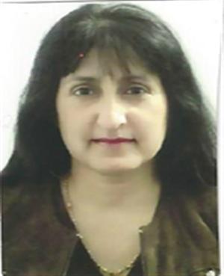
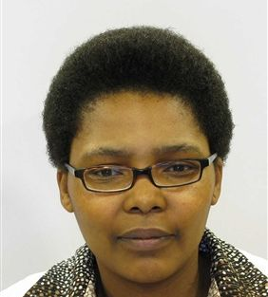

Contact Details
Division Manager: CBS Ms R Begg
Office 021 403 2955/3498
Cell 060 508 2108
Email rbegg@parliament.gov.za
Acting Section Manager: Committees Dr T Ganyazo-Twalo
Office 021 403 3813 / 2597
Cell 061 472 9425
Email ttwalo@parliament.gov.za
Co-ordinator: OLOGB Ms J Cornish
Office 021 403 2353 / 2635 Vacant
Cell 083 445 9229
Email jcornish@parliament.gov.za
Acting Section Manager: Public Participation Mr B Simons
Office 021 403 3388
Cell 063 503 2310
Email bsimons@parliament.gov.za

